Slide 1
Data Analytics bootcamp Monday - Day 1
Dr. Michael Salé – Winter 2018

Slide 2
agenda
Introductions and what each of us want out of the course
About the course and expectations
Account and software housekeeping
About the software we will use and other data analytics software
Basics of data analysis (big data, data science, data analytics, business analytics, business intelligence, etc.)
Analytics/data mining cycle
Populations and samples (n=1, n=all)
Design of experiment
Asking the right questions (What is a problem and what is a symptom?)
*If time Permits: Agile concepts

Slide 3
Introductions
Introduce yourself
Name
Major
Class of 20xx
Computer expertise
Math courses you have taken
Computer science courses you have taken
What you hope to get out of this course/why you took this course. Be specific
How you might see yourself using these skills in your career

Slide 4
About the course
Prep week
In class – 5 days (Mon-Fri) 9am-4pm – break for lunch around 12 for 45 min.
Third week: exploration project – due Friday at 11:59pm on GitHub
Course is a 36,000, nay, 50,000 foot overview in some areas and a “we’re flying so low we might crash” in other areas. ☺
Provides you with hundreds of $ of resources you can keep and continue to use (books, DataCamp {6 months}, articles, software) - learning should go on after this course. I am here for help. Come see me to talk about your specific goals and we will devise a plan of attack.
Course includes a lot of theory and a fair amount of practice on almost perfect cases. You will read a lot about other companies to provide context.
Let your guard down. We are all learning something. Don’t think you know everything or get frustrated if you are confused. Chances are, I am, too!
There will be lots of math. That’s ok, and it’s fun. Lots of resources I’ll give you to help you learn it.

Slide 5
Expectations
Please do the reading – a lot of it will be in preparation for the next class and you will have to do it overnight. Take notes on what you read. Make notes on slide deck. You won’t understand it all.
Participate in class – ask questions, be inquisitive, create a dialogue, don’t fade off, use your technology for class, not recreation. – 10%
Learn R using DataCamp – you have to finish Beginner and Intermediate as well as one other course of your choosing – 20% (You have DC for 6 months to explore more courses)
In and out of class activities (mostly in) – 20%
Answer questions in Doing Data Science and other posed questions – 15% (?)
Data exploration (fun) project - 35%
Everyone should get an A

Slide 6
A LOT of information coming your way

Slide 7
ACCOUNT AND SOFTWARE HOUSEKEEPING
SLACK
DATACAMP
GITHUB username
JMP
POWER BI
EXCEL
If you want R on your laptop https://www.r-project.org/
We need to make sure everyone can commit to GitHub, so we need to learn GitHub soon.
GITHUB software

Slide 8
Other software
Languages: R, python, Java, others?
TONS of R varieties and add-ons
The problem with R
Visualization: R does some (ggplot, etc.), Tableau, Power BI, Excel, JMP, Qlik, SAS and Oracle Visual Analytics – all have some problem with them.
Statistical: SAS, JMP (by SAS), SPSS (IBM), Excel ☹, R

Slide 9
Defining terms
What’s the difference between data science, data analytics, business intelligence, big data????
Do some research on your own for 10 mins and come back to discuss.
Why is this data so “big?”
The V’s

Slide 10
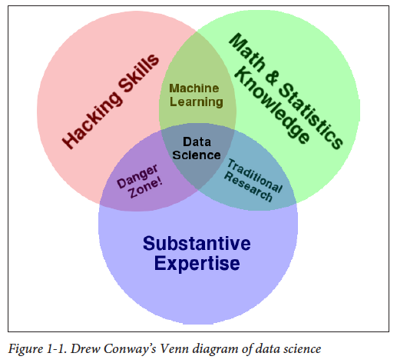
Data science venn diagram

Slide 11
Scientific method

Slide 12
Data analytics cycle
https://www.promptcloud.com/beyond-big-data-in-marketing-predictive-analytics-for-the-smart-marketer/

Slide 13
Data Mining process
CRISP DM

Slide 15
What is a model?
How does your data seem to fall when observed?
Not all data falls in a typical “named distribution”
Named distributions: normal, uniform, t, exponential
What is “fitting?”
What is “overfitting?”
Wat is “over-extrapolation?”

Slide 16
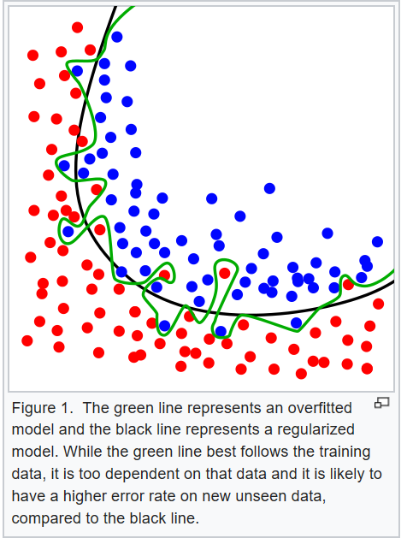
Overfitting
In statistics and machine learning, one of the most common tasks is to fit a "model" to a set of training data, so as to be able to make reliable predictions on general untrained data. Overfitting occurs when a statistical model describes random error or noise instead of the underlying relationship.

Slide 17
Over-extrapolation
Using a model to predict outcomes with data that is very unlike the data used to build the initial model.
Would you use a model created with non-profit financial information to predict revenue for a major tech Fortune 50 company?

Slide 18
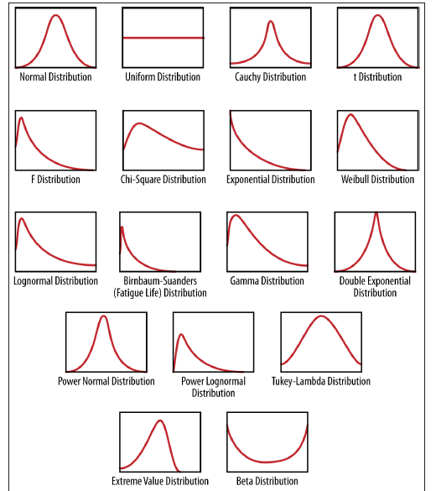
Continuous density functions

Slide 19
Thinking about populations and samples
Population versus samples
Why we usually don’t use population data
Why we CAN use population data (n=all)
How do we choose who/what we want to analyze
Sampling frame
When do we want to sample?
Sampling methods
SRS, Stratified, Cluster, others.
Why is n=1 also important?

Slide 21
Design of Experiment
See book in “resources” on GitHub.
How do you ask the right question? What is a question for simple statistical analysis and what is a question for data analytics/data science investigation?
Is there an overlap?
What is a problem versus a symptom?

Slide 22
Agile?

Slide 23
Questions & discussion

